Slide 1
Master in Communication Science
Virtual Open House Day 2025

Slide 2
Introduction
Director of Studies Univ.-Prof. Dr. Desiree Schmuck
Program Administrator Dimitra Eisterer Petimeza, B.Ed. MA
Notes:
0

Slide 3
Overview
Introduction
Getting to know the Department
Curriculum Overview
Application & Admissions
Questions and Answers

Slide 4
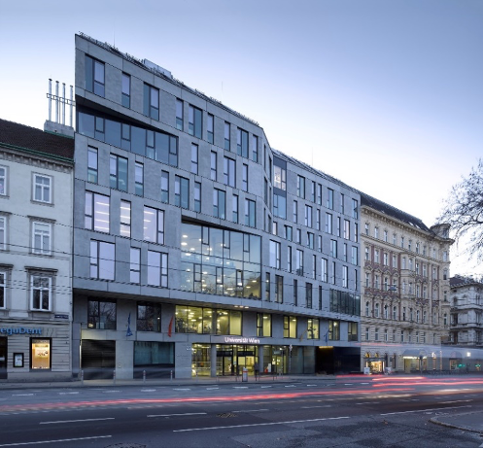
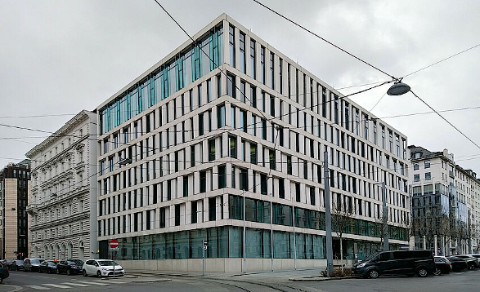
Department of Communication
was founded in May 1942
is one of the world’s largest departments for communication science
has approx. 3,700 students, more than 90 employees and more than 140 lecturers
offers German-taught BA and MA programs, and the English-taught MSc program

Slide 5
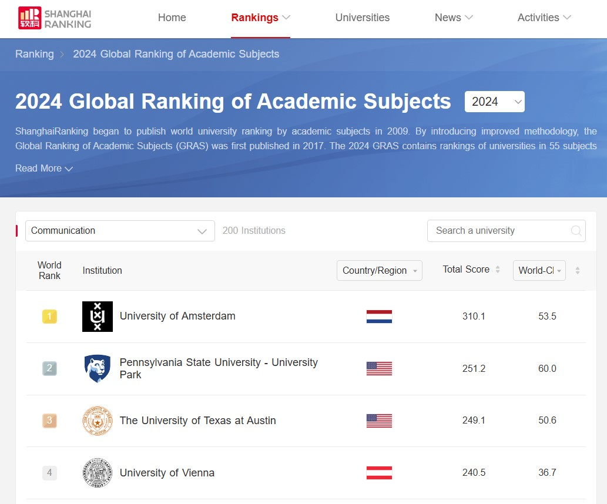
Department
of Communication
ranked as one of the top schools for communication science in the world!

Slide 6
Our Research Areas
Journalism
Media Governance
Political Communication
Strategic Communication
Media History
Methods & Computational Communication Science
Media & Innovation
Media & Entertainment
Health Communication
Feminist Media and Gender Research

Slide 7
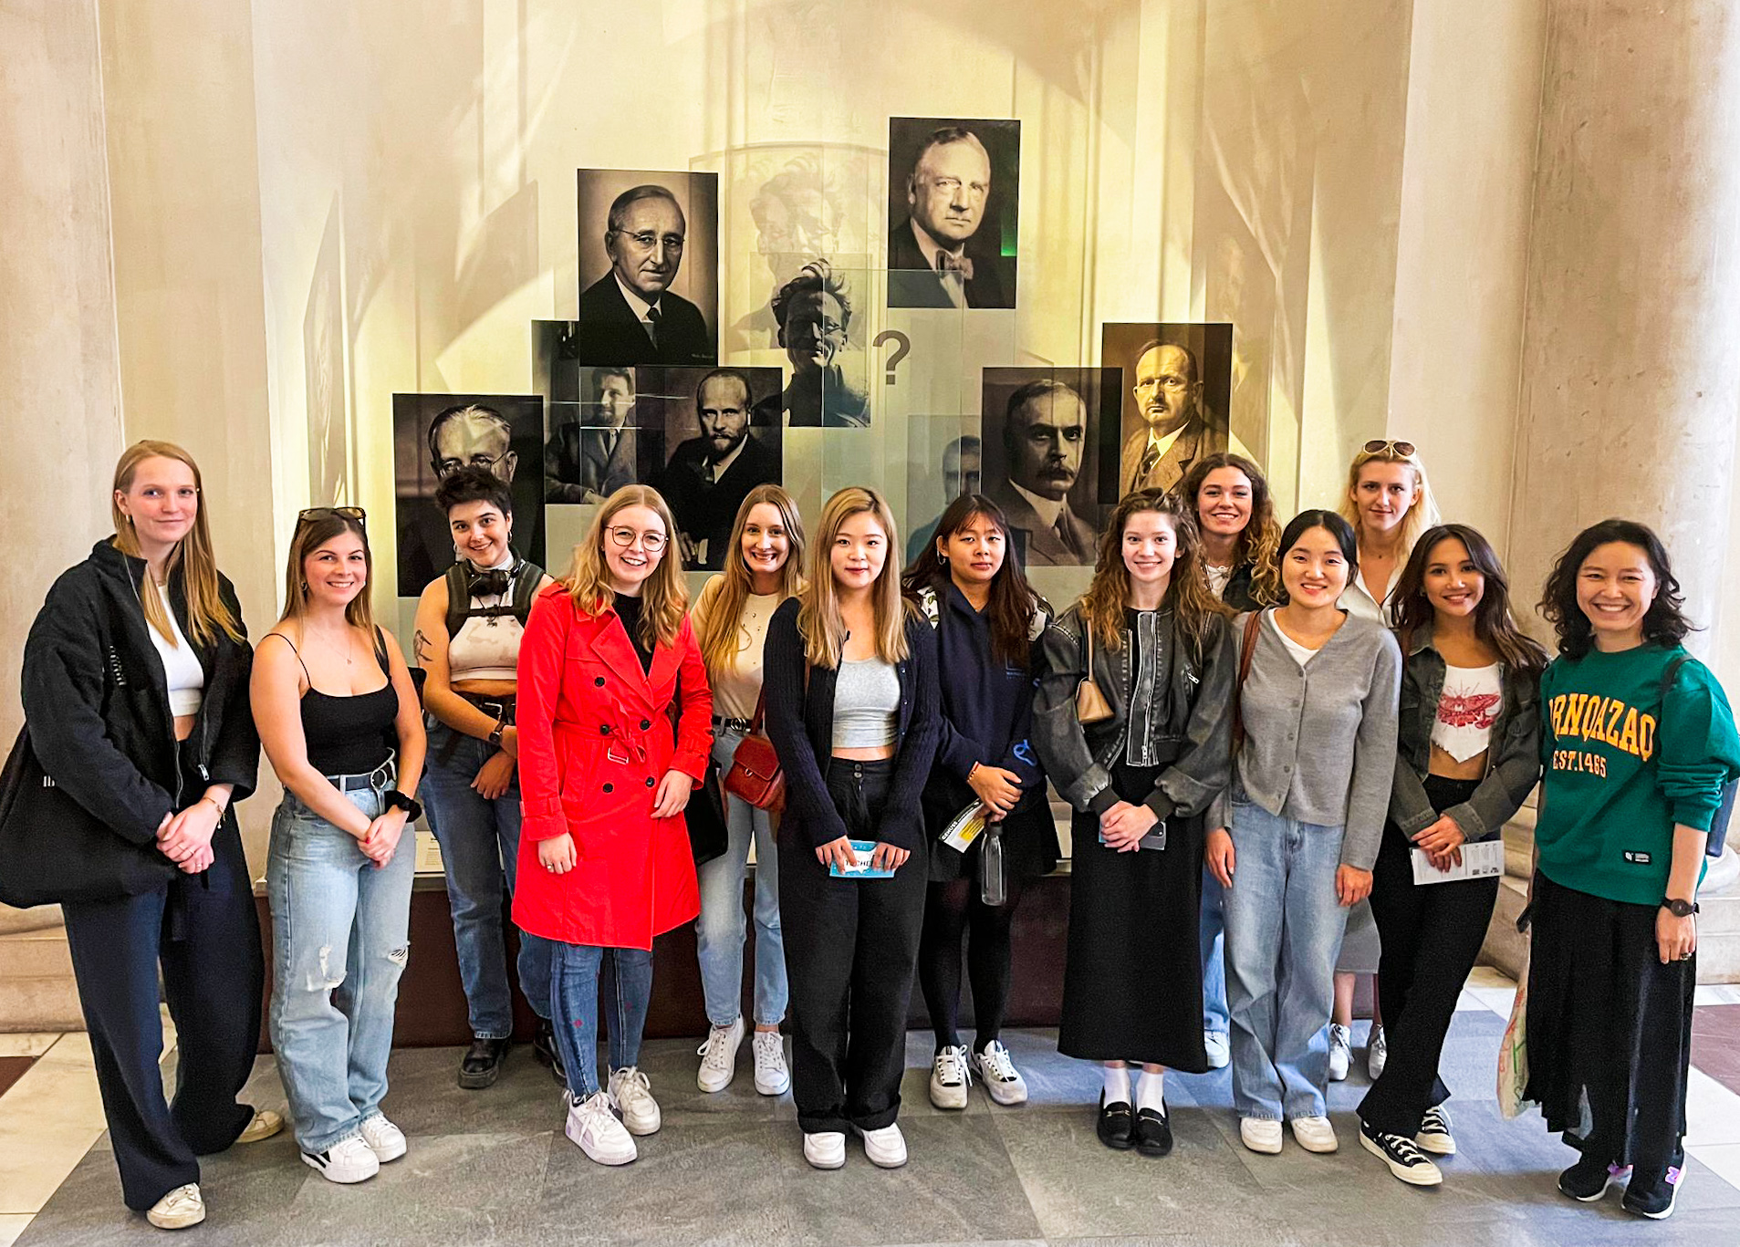
Master of Communication Science
International
Research-Oriented
Approx. 40 students accepted each year
Classes only start in the winter term (October each year)
Notes:
In 2024, we had a total of 370 applications for the Communication Science Master this year (record number)
166 were short-listed
46 selected
31 started (two of them are here today: Daisuke and Bhumika)

Slide 8
Master in Communication Science
Our Master in Communication Science is a two-year MSc degree program, in which you'll gain an in-depth understanding of communication processes on individual, organizational, and societal levels.
The program is research-oriented, which means that you will acquire
broad knowledge about theory in communication science,
a specialized understanding in different areas of communication research such as media and politics, strategic communication or journalism
as well as state-of-the-art methodological skills.
Notes:
The workload for the completion of the Master's Degree program in Communication Science is 120 ECTS points. This corresponds to a planned duration of full-time study of four semesters.
Graduates of the master program Communication Science are awarded the academic degree "Master of Science" - abbreviated MSc.
Our master's program in Communication Science offers you a unique opportunity to study at one of the leading departments for communication research in Europe. The key trademark of our program is that you will be actively involved in rigorous research projects closely working with distinguished faculty members who regularly publish in the top outlets of our discipline. We offer a fascinating and challenging curriculum on pressing questions at the intersection of media and society bringing together a diverse group of students from all over the world who will develop their full potential as scientists and professionals

Slide 9
Master in Communication Science
The master program qualifies for research-oriented activities, especially in the following professional fields:
Leading PhD programs in Communication Science worldwide
Opinion, market, and survey research
Media research (e.g., agencies, publishers, broadcasters)
Media and communications consulting
Media and communications management
…

Slide 10
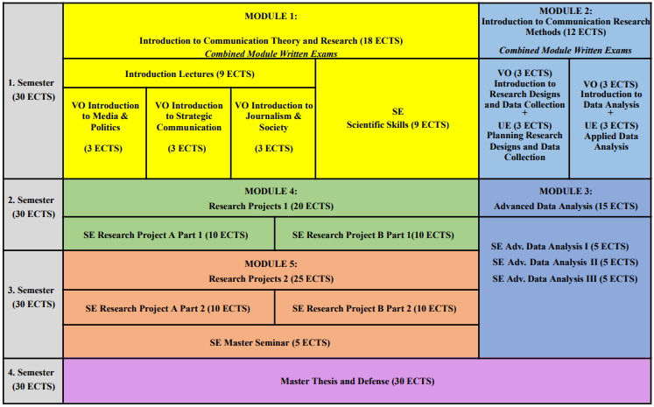
Our Curriculum
Notes:
Erstes Semester am vollsten, Introduction
Grundlagen Kowi-Fächer und Methoden
Research Projects: in drei Bereichen angeboten (Media/Politics, Strategic Comm, Journ & Soc), zwei auswählen, geht über zwei Semester
Master seminar vorbereitung mA thesis
MA Thesis im 4. Semester
Advanced Data Analysis
Schedule not very flexible; classes only offered once a year.

Slide 11
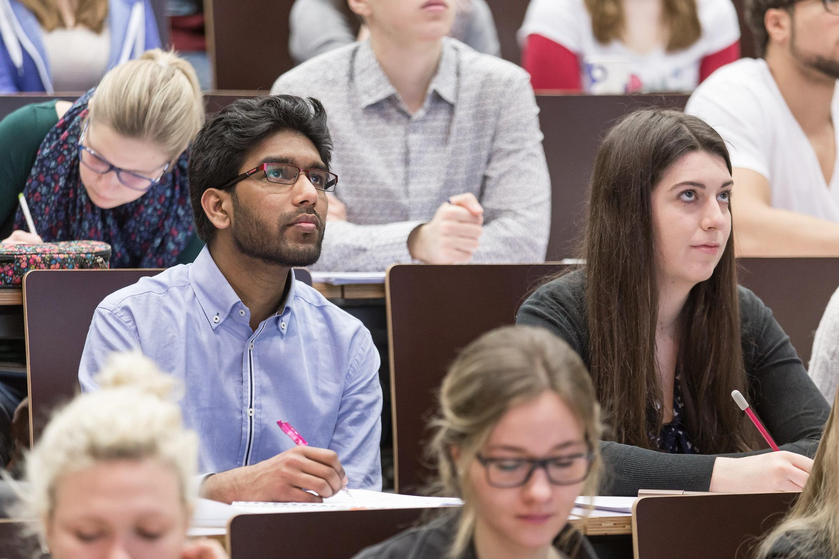
Module 1: Introduction to Communication Theory & Research
Introductory Lectures
Media & Politics
Strategic Communication
Journalism & Society
Scientific Skills

Slide 12
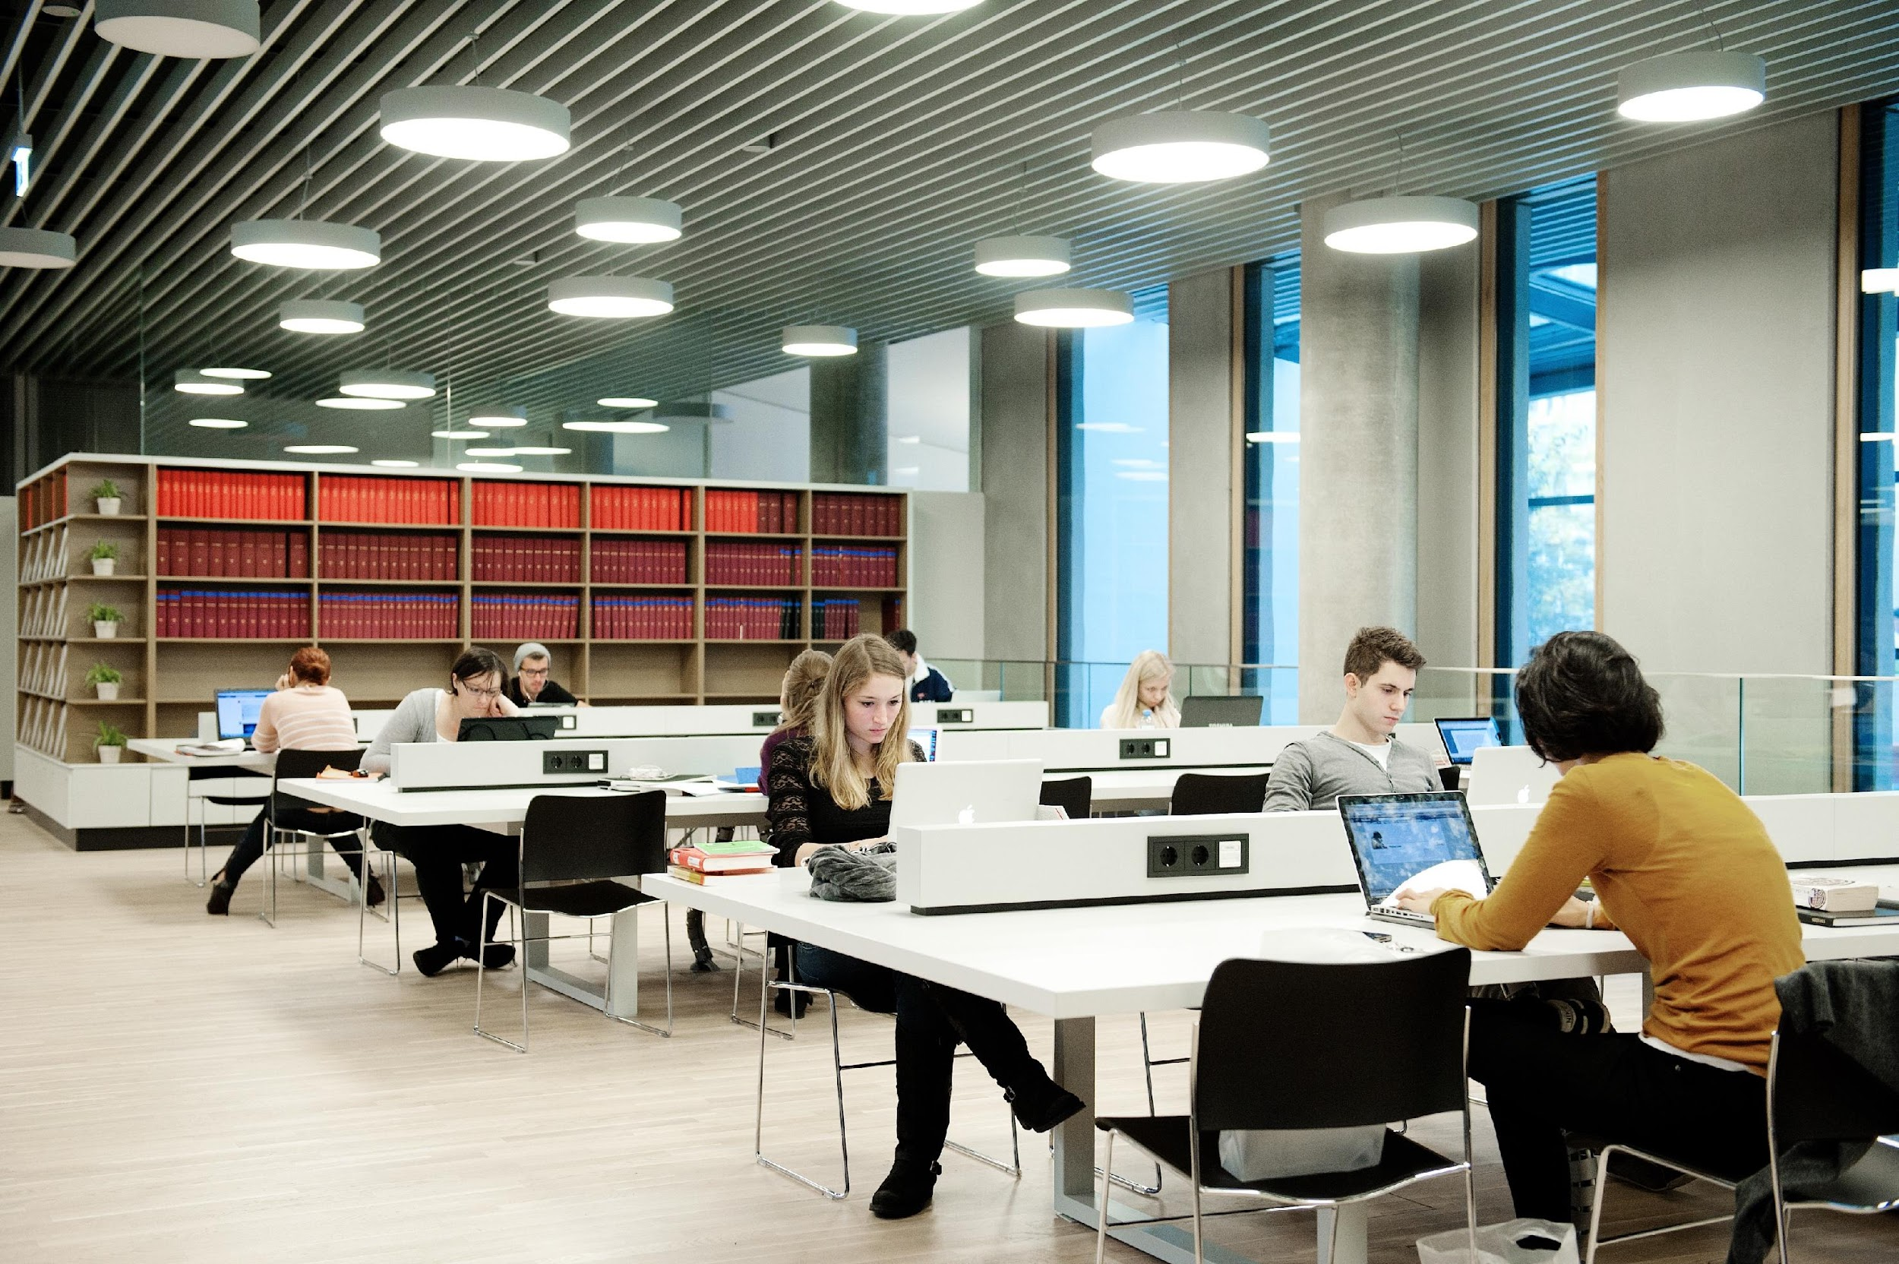
Module 2: Introduction to Communication Research Methods
Introduction to Research Design & Data Collection
Planning Research Design & Data Collection
Introduction to Data Analysis
Applied Data Analysis

Slide 13
Module 3: Advanced Data Analysis
Three specific data analysis methods
Advanced Data Analysis I
Advanced Data Analysis II
Advanced Data Analysis III

Slide 14
Module 4 & 5: Research Projects & Master’s Seminar
Research Project A
Research Project B Choose two areas from three:
Media & Politics
Strategic Communication
Journalism & Society
Master’s Seminar

Slide 15
Master’s Thesis
Individual research project
Supervised by one professor
Starts in the third semester
Completed in the last semester
Defended in Master’s examination

Slide 16
Application and Admissions
The application period for the academic year 2025/26 will take place from March 3 until April 7 2025.
Notifications on admission by end of May of each year.
Requirements/documents:
Higher education degree certificate and transcripts/diploma supplement (at least 150 ECTS for a bachelor degree with 180 ECTS):
with the required legalisation according to the issuing country
with a sworn translation (if not issued in German or English)
merged into one PDF-file
Proof of English proficiency (B2) (find more info here)
Statement of purpose/motivation letter
Full curriculum vitae in English
Proof of identity (passport or ID card, front and back)
More info here:
https://studieren.univie.ac.at/en/admission/master-programmes/communication-science/
Notes:
150 to 200 applications. Competitive!
First, check of formal requirements and English proficiency. We also check if you have a degree in the social sciences.
Then, application committee of three profs reviews applications. We look at CV and statement of purpose: excellence (grades), research experience (student projects, student assistant jobs, pubs) and research motivation, methodological skills for empirical research (statistics), practical experience, extra-curricular activities, English proficiency, intercultural competencies
We look for excellent, open-minded, curious, and diverse students.

Slide 17
Statement of Purpose
Clearly address these questions in separate sections:
What is your personal motivation to apply for this program?
In which ways do you think your prior experiences, qualifications, and skills will support your studies at our department?
What do you expect to learn in doing the master program, and which role does it play in your further academic, personal, and professional development?
More information on formal requirements of the statement here:
https://studieren.univie.ac.at/en/admission/master-programmes/communication-science/
Notes:
Mention your research experience and motivation to pursue research!

Slide 18
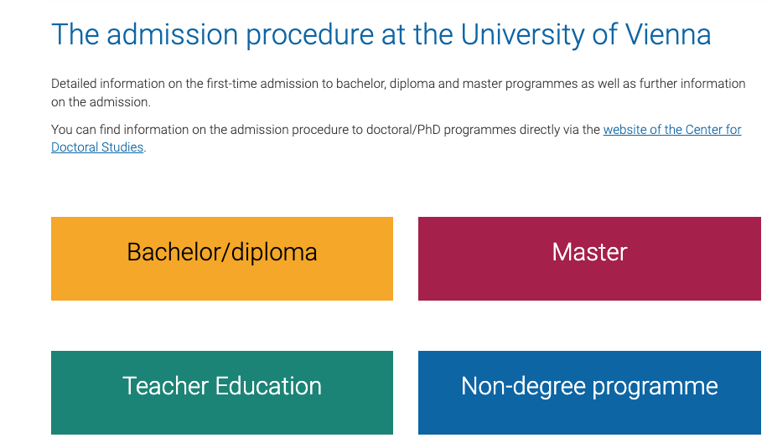
Admission Office
Main Page: https://studieren.univie.ac.at/en/admission-procedure/
Contact Form: https://studieren.univie.ac.at/en/contact-form/

Slide 19
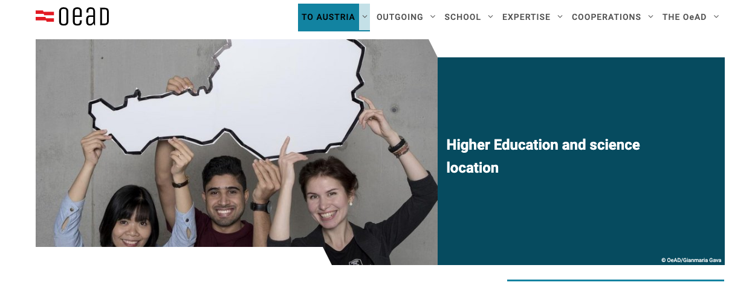
OeAD, Austria’s Agency for Education and Internationalisation
Study and Research in Austria: https://oead.at/en/to-austria
Entry and Residence for Students and Researchers: https://oead.at/en/to-austria/entry-and-residence

Slide 20
Student Representatives and Buddies
Each cohort elects 1-2 student representatives, who attend meetings with the faculty and give feedback on student matters
Student buddies are volunteers who help new students adjust to the university life, especially during the first few weeks
Student-led Instagram page: @univiecommscience

Slide 21
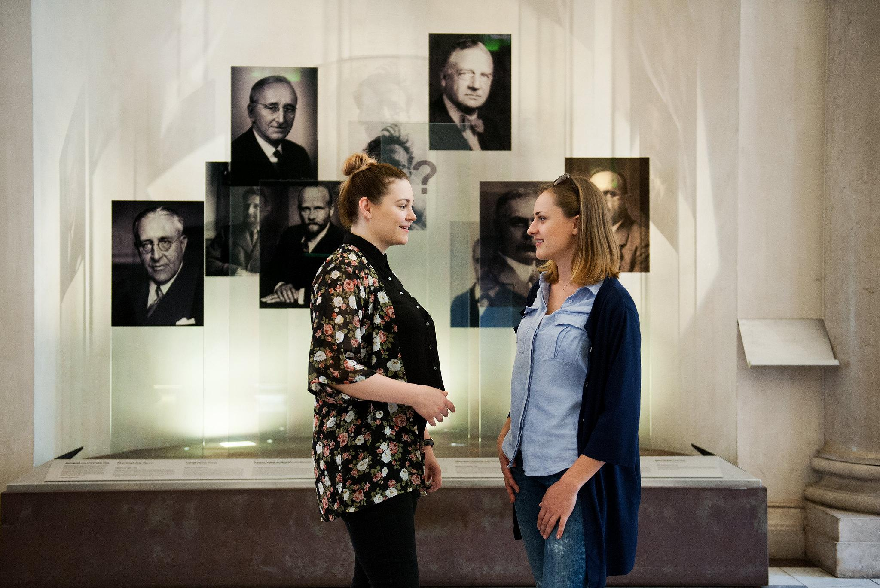
Questions and Answers
For more questions, please contact
Our Program Administrator at
commscience@univie.ac.at

